Slide 1






Notes:
https://slack.com/downloads/windows https://www.jetbrains.com/idea/download/?section=windows https://github.com/login https://git-scm.com/downloads

Slide 2
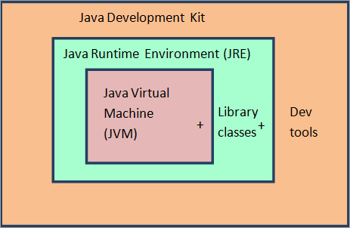
JDK – Java Development Kit : JDK is what we need to compile Java source code
JRE - Java Runtime Environment : JRE is what we need to run a Java program JVM - Java Virtual Machine: JVM is an abstract machine.

Slide 3
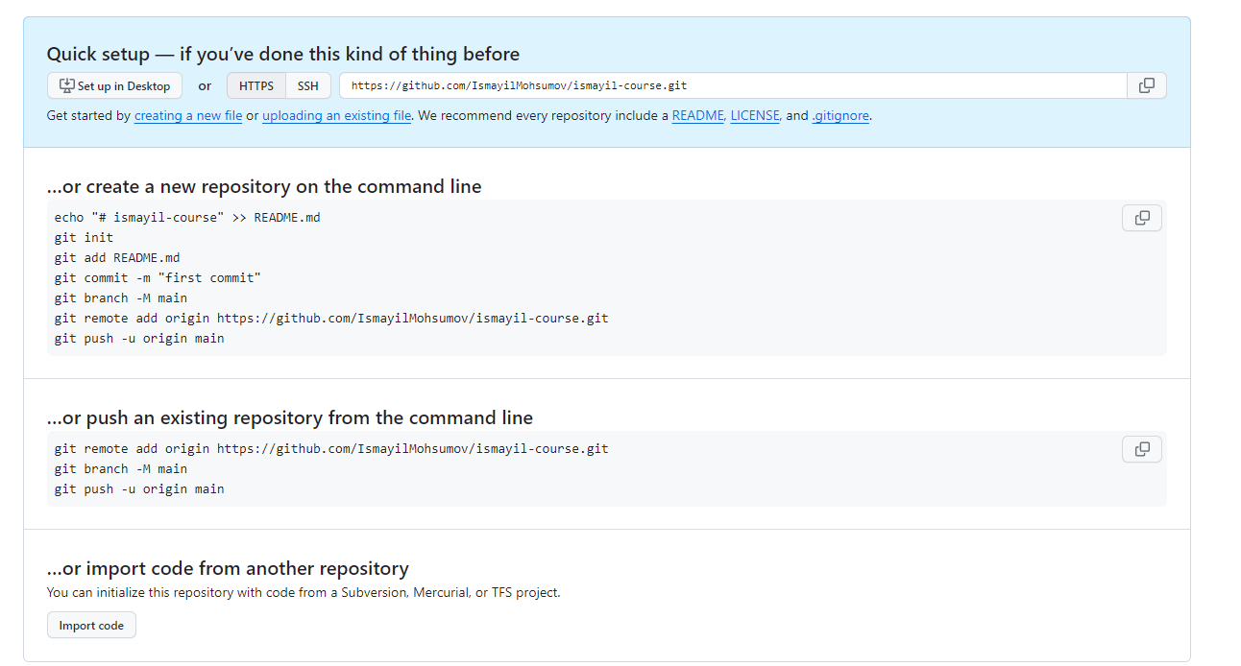
Github – Git Configuration

Slide 4
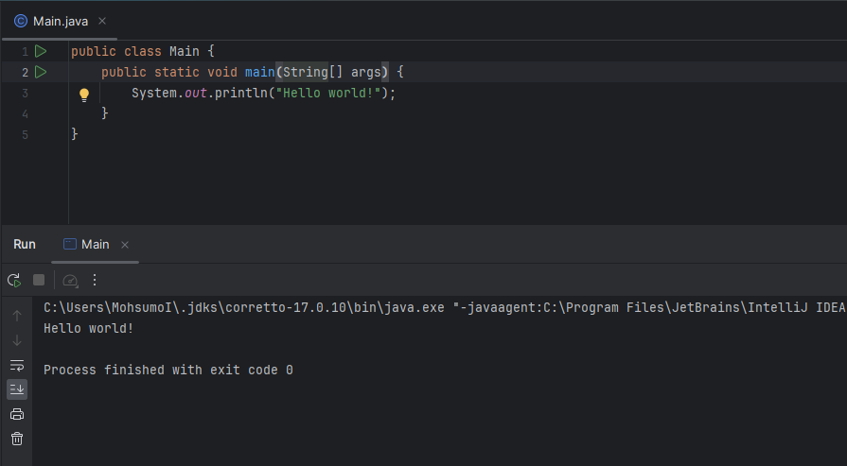
Java Hello World Project

Slide 5
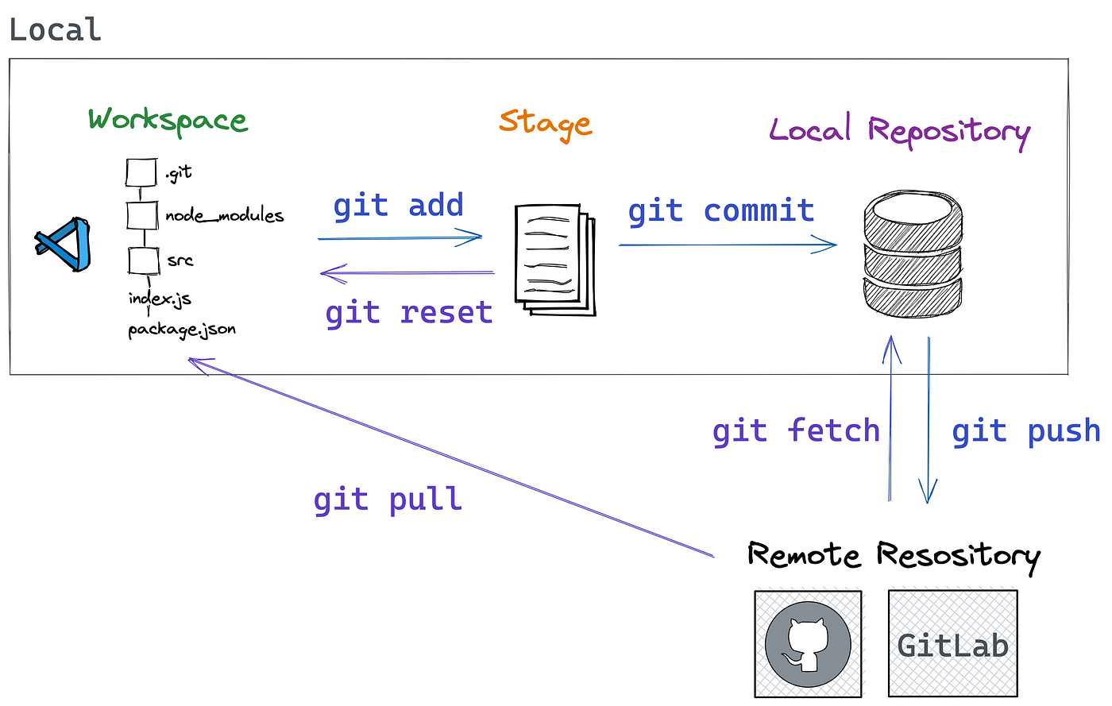
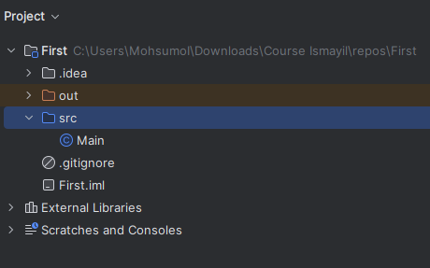
Github Collaboration :
Branching
Collaborating
Packaging
Pull requests
Basic Git commands
.gitignore

Slide 6
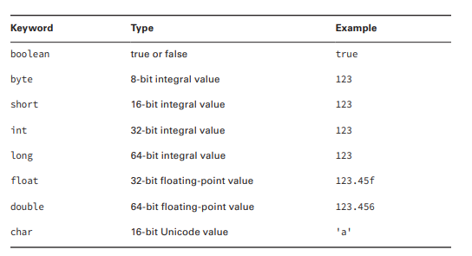

Java Basics :
Comments
Naming Convention
Data types
Swap two variables
Operators
Expressions
Scanner – input

Slide 7
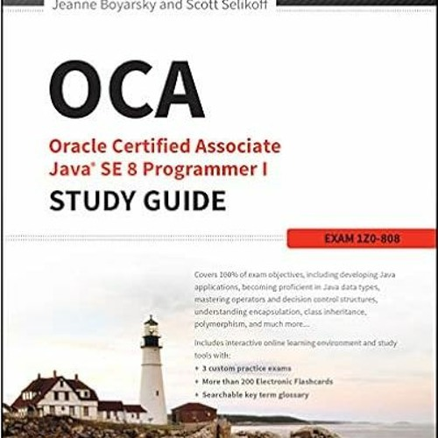
Gələn dərs üçün notlar :
Kitab
Github - PR

